Slide 1


Traffic Signal Optimization using Q-Learning and SUMO
Nine Yin Manuel
Alan & Jason

Slide 2

1.Improve traffic flow using an AI agent
Objective
2.Replace traditional fixed-timing traffic lights
3.Focus on one busy intersection
Taipei Station area

Slide 3
Simulation Environment
Platform: SUMO + TraCI + Python
Intersection: 4-way (East-West, North-South)
Map: Downloaded from OpenStreetMap
Vehicles arrive probabilistically, simulating peak/off-peak
返回議程頁面

Slide 4
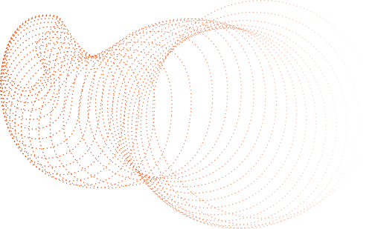
Training Configuration
Parameter | Value
Episodes | 1000
Learning Rate | 0.1
Discount Factor | 0.9
Epsilon | 0.1

Slide 5

Q-Table
maps states to action values
Action Space:
[0 = East-West green,
2 = North-South green]
Q-Learning Overview
Learning Process
1000 episodes
SUMO simulation steps
10 steps per action

Slide 6
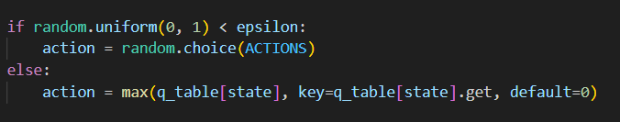
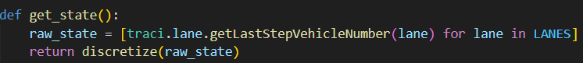
The action space is the set of all possible choices that the agent can make at each time step.
The agent controls "in which direction to turn the green light"
0 → Turn the East-West lane green
2 → Turn on the green light for the North-South lane
raw_state[i] is the exact vehicle count on lane i at that moment.

Slide 7
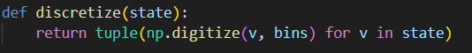
State Space
Why Discretize?
Number of vehicles per lane (12 lanes)
Each lane count discretized using bins: [0, 5, 15, 30]
Bin 0: light traffic
Bin 1: medium traffic
Bin 2: heavy traffic
Final state: tuple of 12 bin values

Slide 8
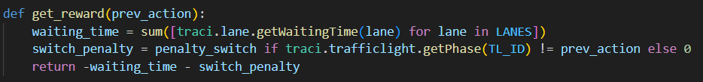
Reward Function
Meaning:
Basic penalty: The higher the total waiting time, the greater the penalty (the more negative the value)
Additional penalty: 5 points if the phase is different from the previous one (i.e. "light cut").
It can effectively avoid frequent switching of traffic lights, so that vehicles will not be stuck or wait repeatedly

Slide 9



Evaluation Process
Use trained q_table.npy
Replay in SUMO using best
Q-values
Record reward per step
Plot total reward vs. steps

Slide 10
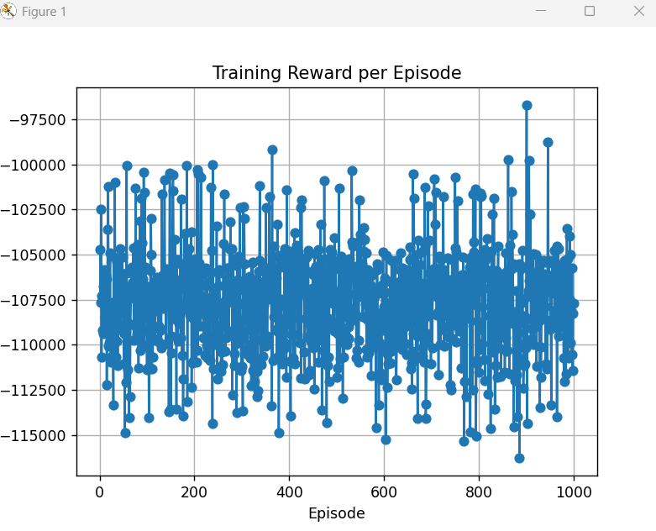
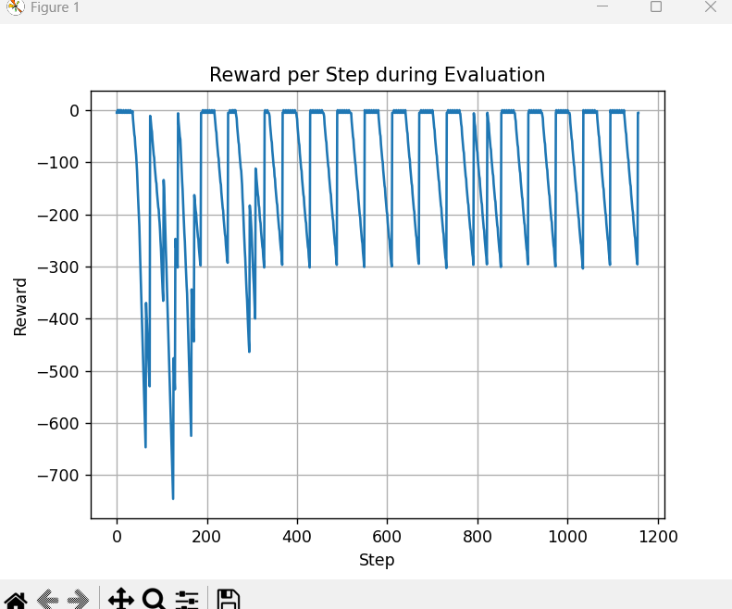
Evaluation Result
Training Result
Reward trend over 1000 episodes
Shows learning progress and convergence

